Slide 1


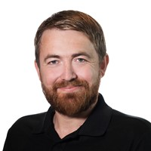


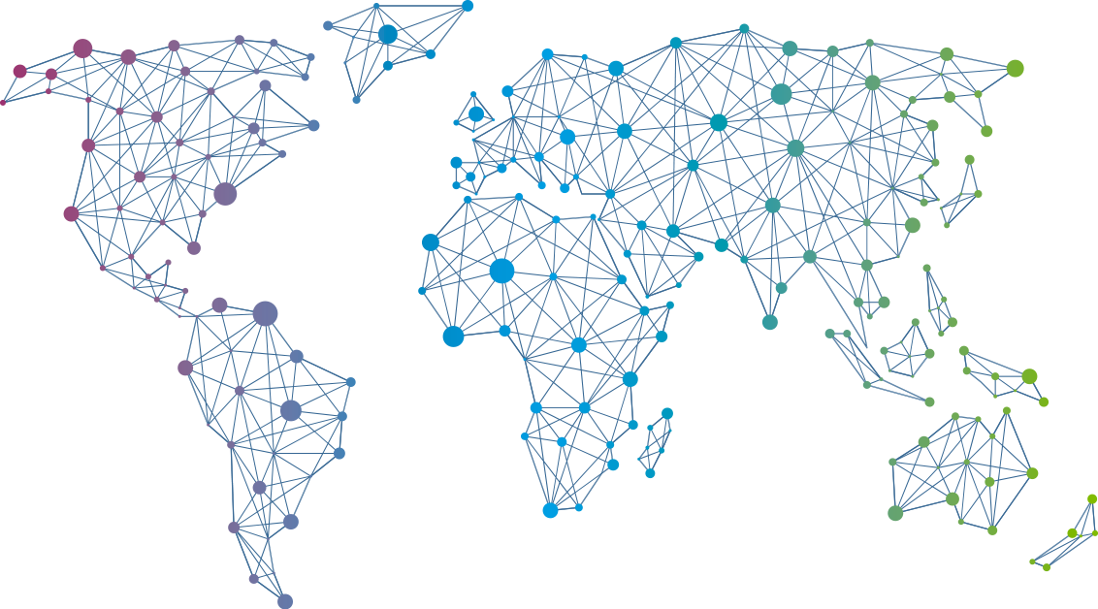

Speaker
Alexander Holmeset
What can be automated as a Teams administrator?
Alexander Holmeset
AlexHolmeset
September 16th & 17th
^{Online Event}
Powered By
International Conference

